Slide 1

WEEK 7
CESAR A, PASCAL

Slide 2
This week, my focus was on implementing a browser-based G1 model that can be shared through a link, making the simulation easily accessible.

Slide 3
Following last week’s progress, where I successfully implemented the model on a local host, this week I focused on making it accessible through a shareable link. To achieve this, I used GitHub Pages, following a similar approach to the one used in MJSwan.

Slide 4
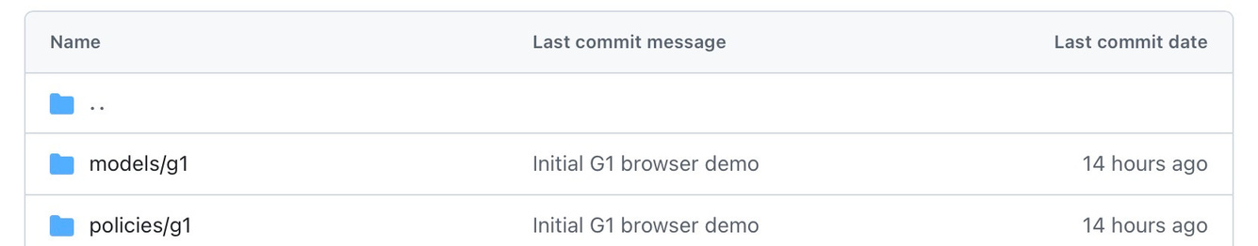
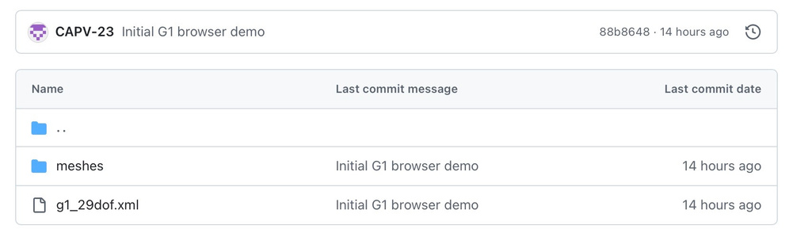
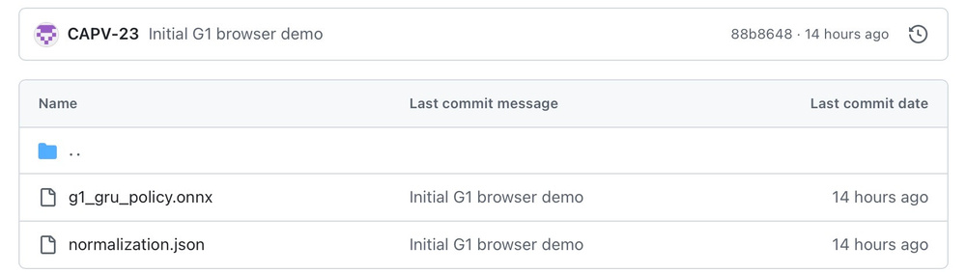
These are the documents needed to run this simulation.

Slide 5
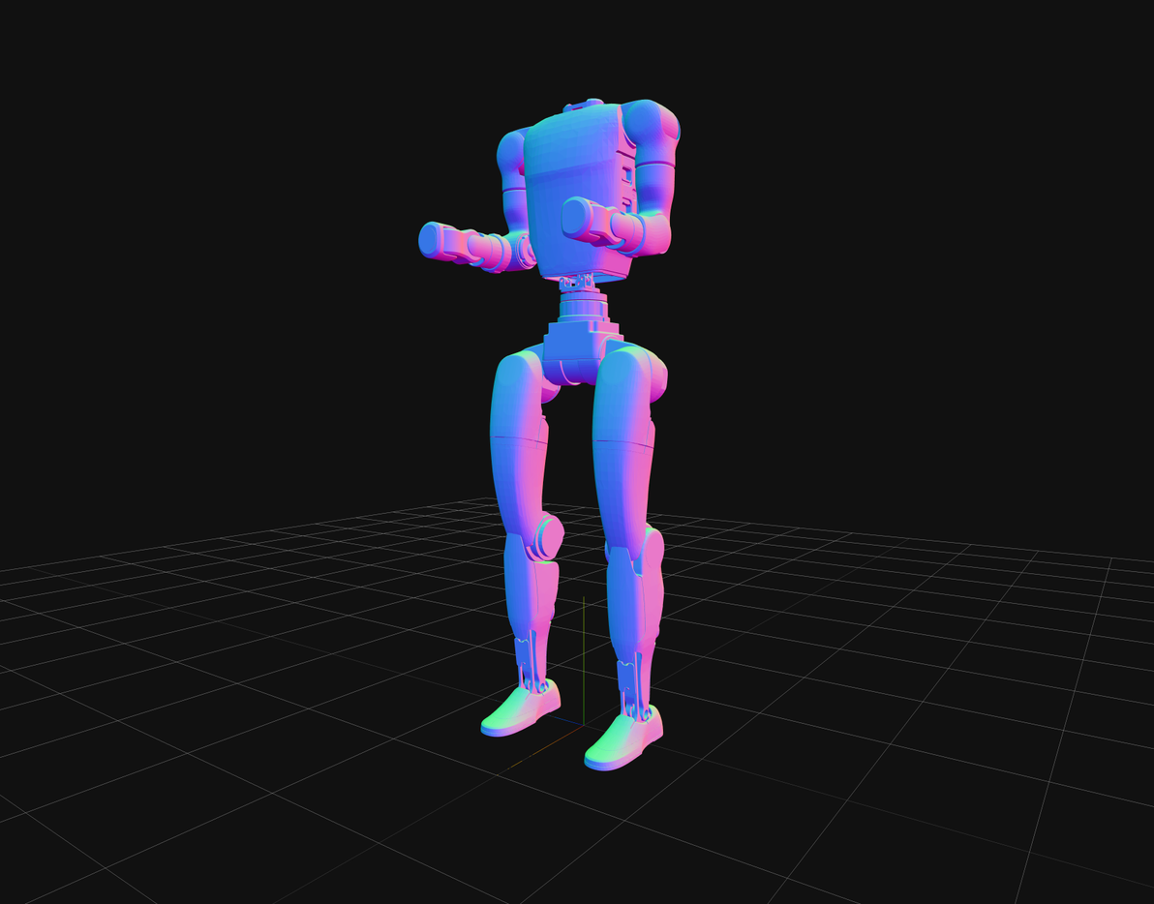
This is the first version of the G1 model uploaded, without any control policy implemented.

Slide 6
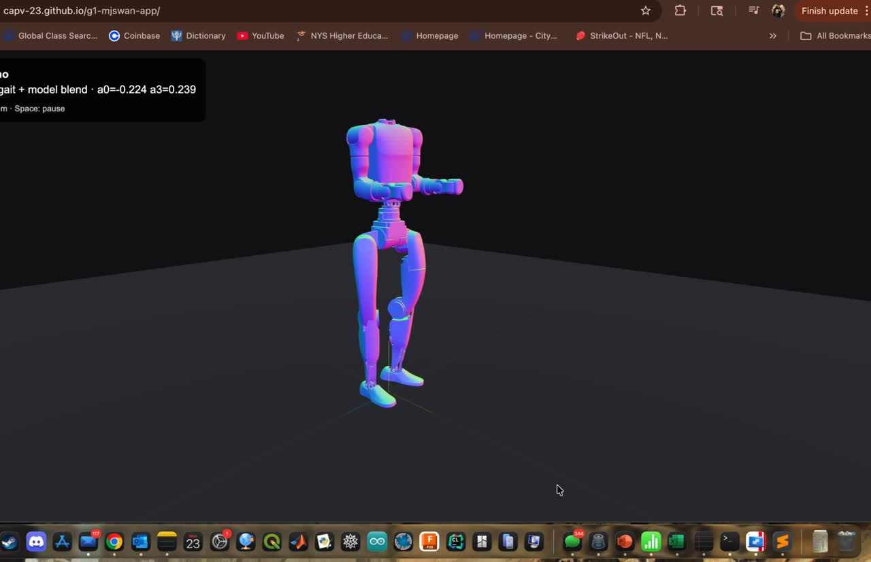
This is the fully integrated and operational version of the model.

Slide 7
Additional refinement is required to correct alignment issues in the mesh geometry and joint parameters. Furthermore, the implementation of a properly trained control policy is necessary to achieve stable walking behavior.

Slide 8
Next Steps
  Refine mesh alignment to ensure accurate positioning of all model components.
  Adjust joint parameters to improve stability and realistic motion behavior.
  Integrate a trained control policy (e.g., GRU/locomotion policy) into the browser simulation.
  Validate the policy performance to achieve stable and consistent walking.
  Improve rendering and visualization to better represent the full G1 model.

Slide 9
References
[1] MuJoCo, “MuJoCo Physics Engine,” DeepMind. [Online]. Available: https://mujoco.org
[2] Three.js, “Three.js Documentation.” [Online]. Available: https://threejs.org
[3] ONNX Runtime, “ONNX Runtime Web,” Microsoft. [Online]. Available: https://onnxruntime.ai
[4] MJSwan, “MJSwan Demo.” [Online]. Available: https://ttktjmt.github.io/mjswan/
Working link: https://capv-23.github.io/g1-mjswan-app/

